Slide 1
OSG202 LAB 03
ASSIGNMENT REPORT
System Attributes,
Using Word Processor
Student
ID
Class
Nguyễn Đăng Lộc
SE160199 SE1602

Slide 2
Table of contents
Process management
03
System commands
04
Using the Editor Program vi
07
02

Slide 3
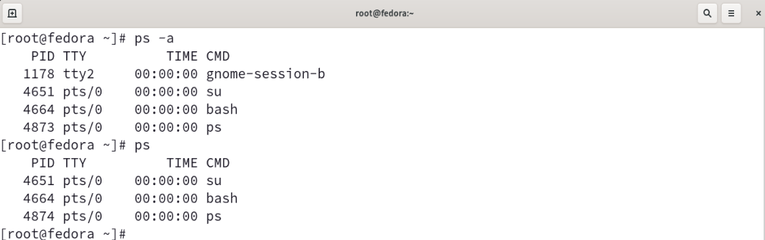
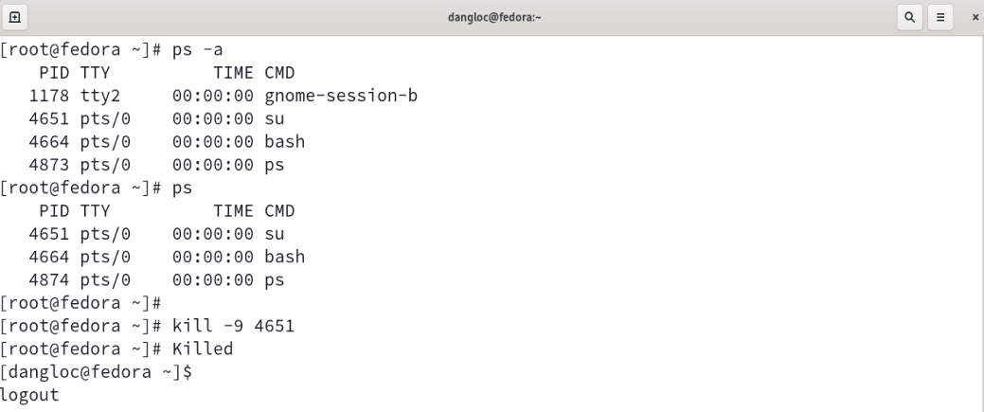
1. PROCESS MANAGEMENT
1.1. View process status (ps)
Syntax: ps [-OPTIONS]…[
Description: report a snapshot of the current processes.
Example:
1.2. Stop a process
Syntax: kill -9 PID
Description: terminate a process
Example:
After killing the process with PID 4651, the status was change from user root (#) to normal user($)
03

Slide 4
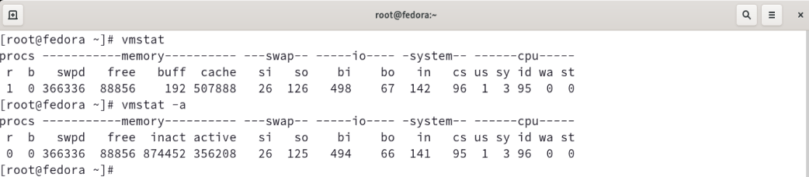
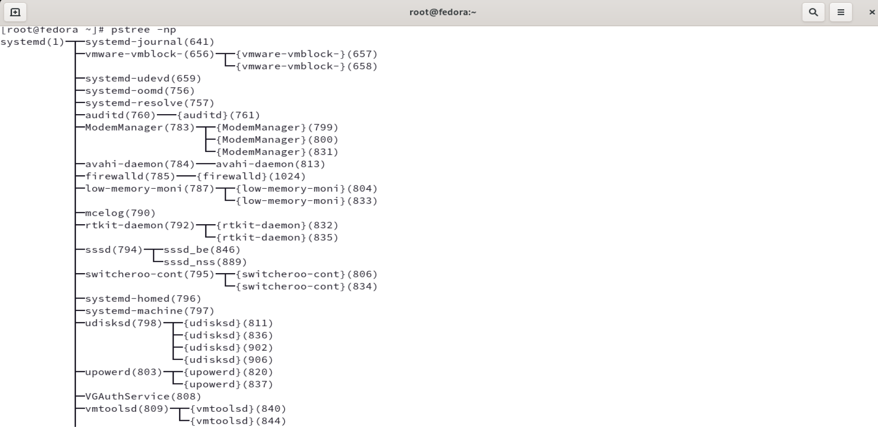
2. SYSTEM COMMANDS
1.1. vmstat
Syntax: vmstat [OPTIONS] [DELAY [COUNT]]
Description: report virtual memory statistics.
Example:
System performance monitoring command that provides data on processes, memory, paging, block IO, disk, and CPU scheduling
1.2. pstree -np
Syntax: pstree [OPTIONS] [USER or PID]
Description: display a tree of processes
Example:
Displaying the running processes as a tree, which is a more convenient manner of displaying the process hierarchy and improves the output's aesthetic appeal.
04

Slide 5
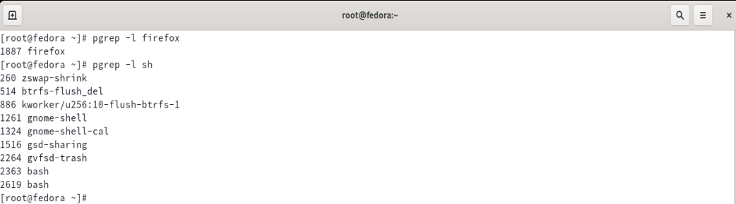
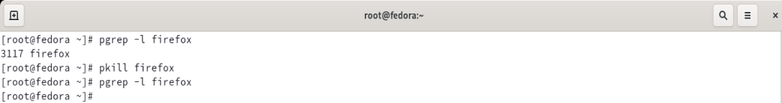
1.3. pgrep
Syntax:
pgrep [OPTION] PATTERN
Description: Looks through the currently running processes and lists the process following name, properties,…
Example:
Displaying the process IDs that match the selection criteria to stdout from the currently executing processes..
1.4. pkill
Syntax:
pkilll [OPTIONS] PATTERN
Description: send the specified signal (by default SIGTERM) to each process instead of listing them on stdout
Example:
Firefox is processing with PID 3177, after use pkill comman, there was no firefox process with 3177 PID.
Use the kill -l command to list all available signals.
The most commonly used signals are:
- 1 (HUP): to reload a process.
- 9 (KILL): to kill a process.
- 15 (TERM): to gracefully stop a process.
05

Slide 6
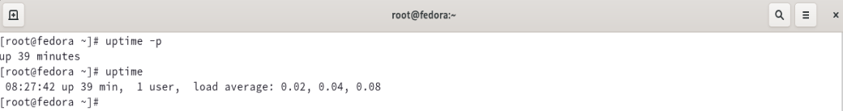
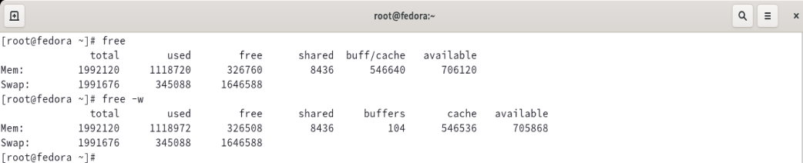
1.5. uptime
Syntax:
uptime [OPTIONS]
Description: Tell how long the system has been running.
Example:
The following information displayed in a single
1.6. free
Syntax:
free [OPTIONS]
Description: Display amount of free and used memory in the system
Example:
Showing how much physical and swap memory is free and utilised in the system, as well as the kernel's buffers and caches.
06

Slide 7
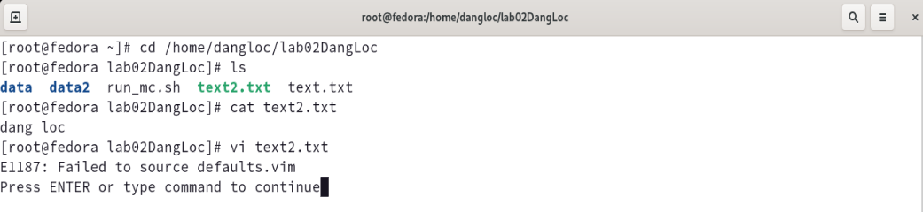
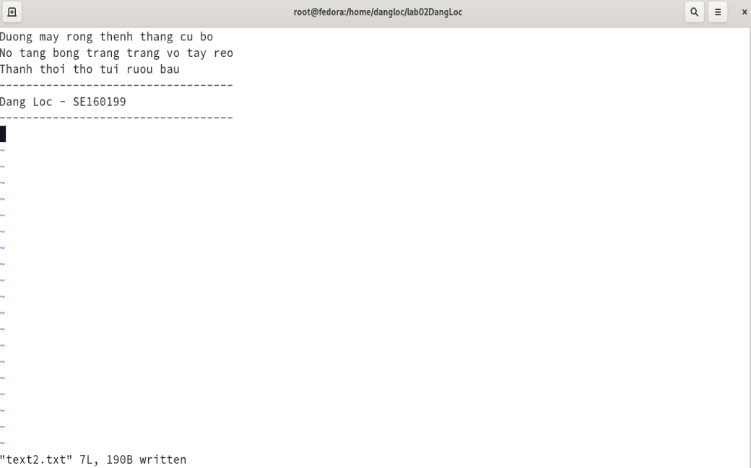
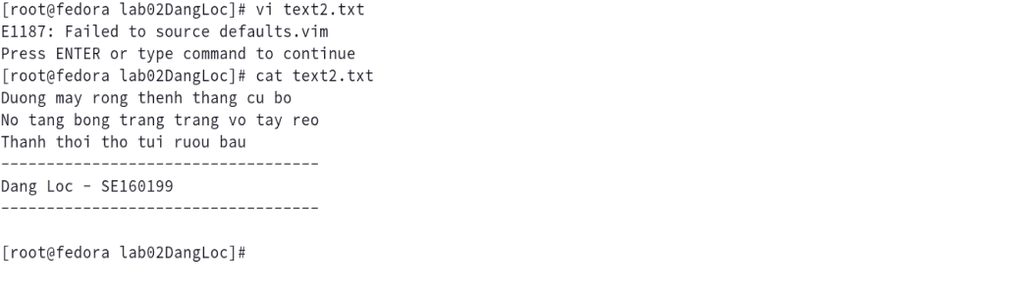
3. Editor program VIM
The file text2.txt in directory lab02DangLoc has the content of “dang loc” in initial.
Use editor program vi to edit the contents in the text2.txt
The contents of the text2.txt was changed.
07

Slide 8
Thank you!
By Nguyen Dang Loc

